Slide 1

Monitoring access to water, sanitation and hygiene for people with disabilities
Rob Bain, UNICEF
Rifat Hossain, WHO
3rd May, 2016
Notes:
Intro WHO/UNICEF JMP – 25 years, final MDG report
Monitoring of access to basic services
Summary of the recommendations of an END working group and recent taskforce deliberations (report forthcoming)

Slide 2
SDG WASH targets and indicators
Target: By 2030, achieve universal and equitable access to safe and affordable drinking water for all
  Indicator: Percentage of population using
  safely managed drinking water services
Target: By 2030, achieve access to adequate and equitable sanitation and hygiene for all and end open defecation, paying special attention to the needs of women and girls and those in vulnerable situations
  Indicator: Percentage of population using
  safely managed sanitation services including hand washing facilities with soap and water
Notes:
Universal and equitable
For all
No longer only tracking access to basic services

Slide 3
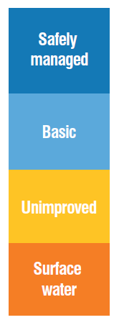
MDG/SDG | Service ladder | Progressive realization | Monitoring ladder
SDG 6.1 | Safely managed drinking water | On premises, available when needed and meets water quality standards | All developed countries, and some developing countries
MDG continuity | Basic water | Improved facility within 30 minutes round trip collection time | Most developing and some developed countries report
 | Unimproved water | Facility which does not protect against contamination | Most developing and some developed countries report
 | No service | Surface water | All countries report (applies to developing countries)
Developing Developed
Notes:
Safely-managed drinking water is the top level for the proposed service ladder, running from no service to s-m
This ladder aims to capture progressive realisation of the HRWS
It is also a monitoring ladder, increasing sophistication of monitoring allows countries to track higher levels of service - in many cases these may happen in tandem.

Slide 4
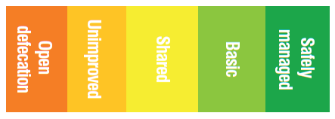
MDG/SDG | Service ladder | Progressive realization | Monitoring ladder
SDG 6.2 | Safely managed sanitation | Beyond basic sanitation facility, safe disposal of fecal wastes on site, or transport and treatment off-site | All developed countries, some developing countries
MDG continuity | Basic sanitation | Private basic sanitation | Most developing and some developed countries report
 | Shared sanitation | Improved sanitation | Most developing and some developed countries report
 | Unimproved sanitation | Fixed point defecation | All countries report (applies to developing countries)
 | No service | Open defecation | All countries report (applies to some countries)
Developing Developed

Slide 5
SDG targets…'leave no one behind'
Disaggregate as relevant
  income,
  sex,
  age,
  race,
  ethnicity,
  migratory status,
  disability and
  geographic location,
  or other characteristics of national relevance
Target elements
  Universal
  equitable
  safe
  affordable
  adequate
  open defecation,
  women and girls
  vulnerable situations
Notes:
Universal and «for all»
Vulnerable situations

Slide 6

Inequalities are intersectional
The SDGs must go beyond identifying inequality by wealth quintiles
The world’s poorest are disproportionately characterized by one or several exclusionary or discriminatory grounds
Caste
Ethnicity
Gender
Disability
Laws, policies, lengthy administrative procedures can also negatively impact on access to water and sanitation services.
  Eg. People with disabilities are socially excluded unless special policies ensure their access in public spaces
Notes:
Message from Special Rapporteur – can’t just look at poverty

Slide 7
Incorporating disaggregated indicators
The human rights to water and sanitation and the human rights principles of non-discrimination and equality inform the framework for monitoring inequalities
The END Working Group suggests a metric comparing advantaged groups with disadvantaged groups. in the following areas of monitoring:
Wealth quintile analysis
Geographic disparities
  a) rural-urban
  b) intra-urban
Group-related inequalities (e.g. based on race, ethnicity and migratory status)
Intra-household inequalities (e.g. based on sex, age and disability)
Service provision must also be monitored in institutions, the workplace and public spaces

Slide 8
Progressive elimination of inequalities
=
Progressive realisation of human rights
Progress among both groups can be followed. Disparity should decrease through time
The world’s most disadvantaged groups must be given priority

Slide 9
Priorities and way forward…
Disaggregation | Priority for WASH SDG | Priority for JMP | In collaboration with | External collaboration
Income (WQ) | Yes | Yes | HHS
Affordability | Yes | Yes | WB, HHS
Sex | Yes | Yes | UNWOMEN, IAEG-gender
Race, ethnicity, religion, education… | Yes | Thematic | IER, etc. | Academia
Migratory status | Yes | Yes (?) | TBC | Academia
Disability (incl age) | Yes | Yes | Disability com | TBC
Subnational (NTD, nutrition), informal urban | Yes | Yes | UNHABITAT
Extra household | Yes | Yes | WHO, UNICEF | Academia
Notes:
Taskforce on inequalities – this is the list of priority equity stratifiers
We hope to work with the disability community

Slide 10
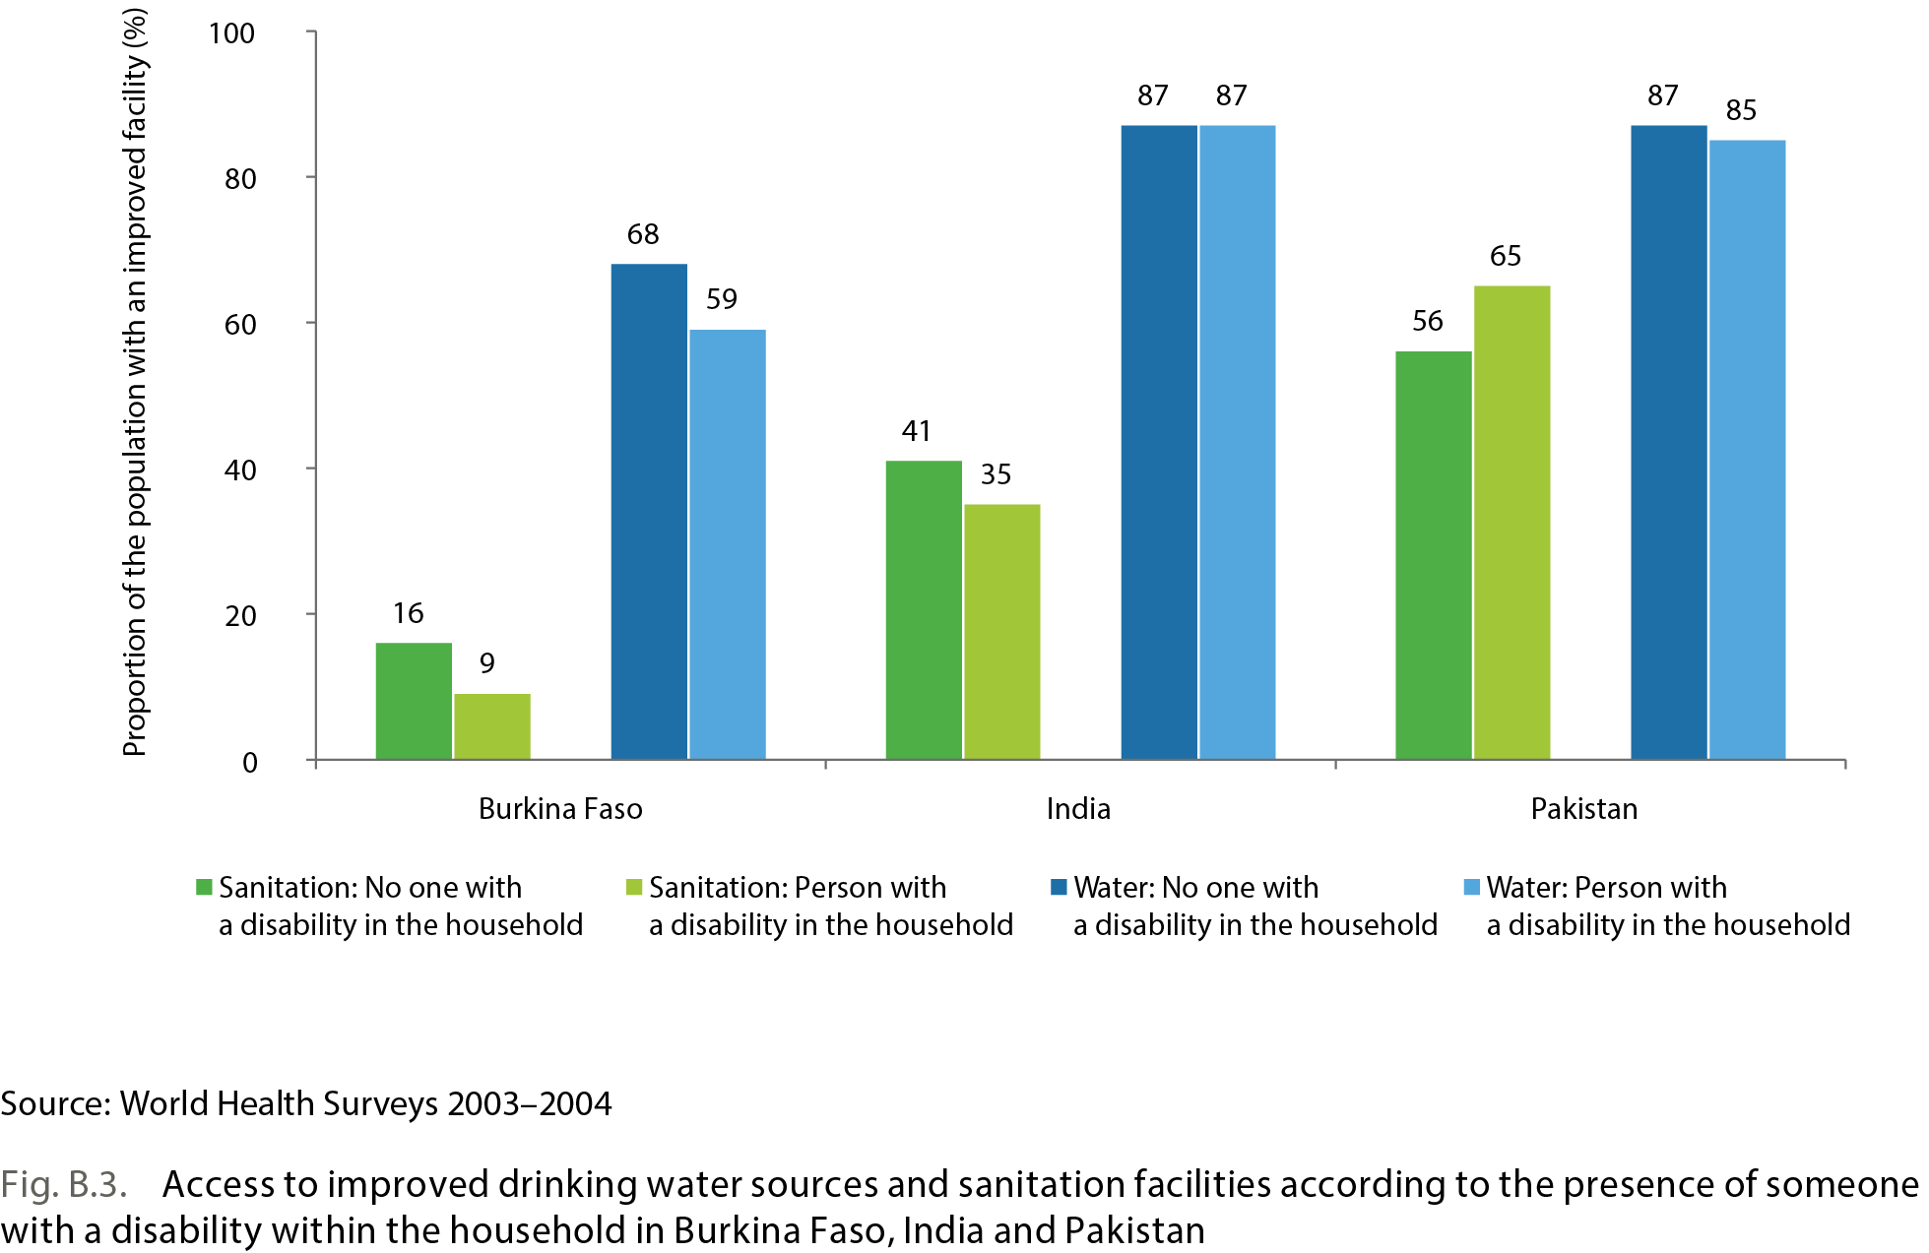
Data: world health surveys in 2003/2004
World Report on Disability used data from World Health Surveys from 50 countries.
JMP analysis: difference in access between household with people with and without disability (35 countries)
Disability: present data does not provide a clear picture of the nature or scale of this inequality
Quantifying differential access within households is difficult.
Notes:
WHS asked “What type of toilet facilities does your household use?“
Disability based on interviewer observations
Notes
Part of this published in 2014 report – quantifying differential access is difficult
Disability module in WHS – randomly selecting a member of household (Kish in the household)
Caveats:
Definition of disability (World report on disability)
Life course – anybody can be disabled
Physical disabilities (only blindness etc)
Hardly any difference in the remaining 15 (some the other way around)
Washington vs alacros

Slide 11
Data: world health surveys in 2003/2004
World Report on Disability used data from World Health Surveys from 50 countries.
JMP analysis: difference in access between household with people with and without disability (35 countries)
Disability: present data does not provide a clear picture of the nature or scale of this inequality
Quantifying differential access within households is difficult.
Notes:
Notes
Part of this published in 2014 report – quantifying differential access is difficult
Disability module in WHS – randomly selecting a member of household (Kish in the household)
Caveats:
Definition of disability (World report on disability)
Life course – anybody can be disabled
Physical disabilities (only blindness etc)
Hardly any difference in the remaining 15 (some the other way around)
Washington vs alacros

Slide 12
Data: 2010 census round in Latin America
In households with and without a disabled person, water and sanitation coverage appears to be similar
Country | Indicator | Disabled | National
Costa Rica CEN2011 (any disability) | Improved water Improved sanitation | 95 97 | 95 97
Ecuador CEN2010 (“permanent” disability) | Improved water Improved sanitation | 81 77 | 83 79
Mexico CEN2010 (physical or mental) | Improved water Improved sanitation | 93 82 | 93 84
Panama CEN2010 (any disability in list) | Improved water Improved sanitation | 92 69 | 93 70
Definitions of disabled vary between these censuses
No information on specific barriers for people with disabilities only access at the household-level

Slide 13
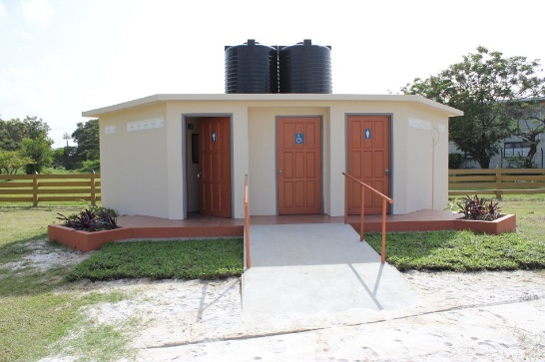
Inclusive and accessible WASH
Inclusive, consultative, participatory with persons with disabilities
Confronting both societal barriers of access and technical/physical barriers
© UNICEF Guyana
Notes:
What do we mean by inclusive and accessible (acknowledge work of
For all with no exceptions
Inclusive approaches need to be fully embedded.
Example from Guyana:
Disabilities-friendly washroom in a fully accessible, state of the art children’s playground Georgetown, Guyana

Slide 14
Conclusions
SDG – “for all” and ambition to leave no one behind must include people with disabilities
There are specific barriers to WASH faced by people with disabilities at home and away from home
Inclusive design with participatory processes can ensure accessibility for people with disabilities.
Household-level monitoring insufficient and specific questions would need to be asked of people with disabilities
The JMP is keen to collaborate with the disability community to explore innovative means of monitoring WASH access

Slide 15
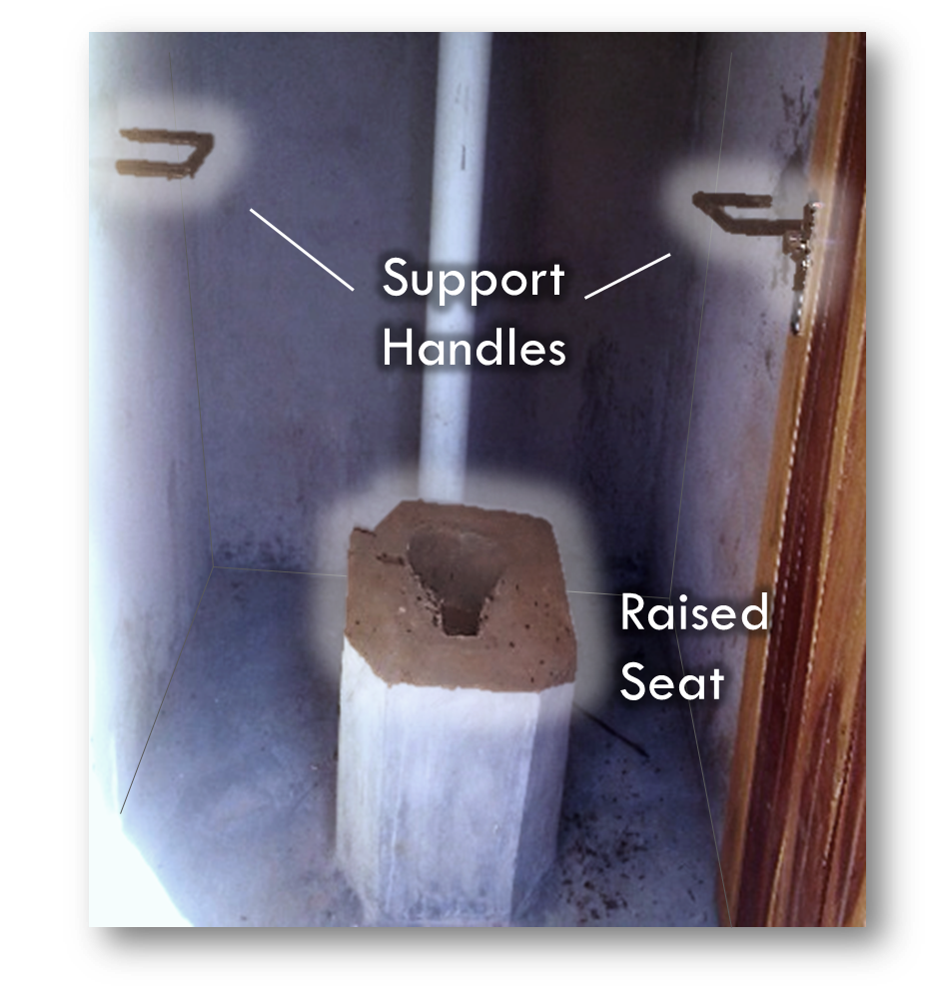
© UNICEF Malawi
Notes:
In Malawi, District Councils commission local masons to build accessible facilities in CFS

